Slide 1


USER MANUAL
WWW.TRACUZ.COM

Slide 2
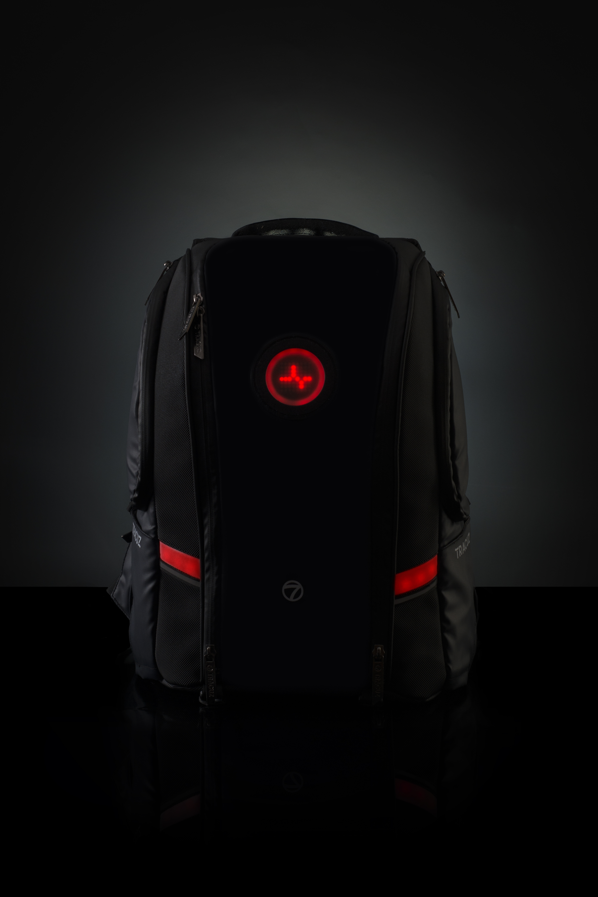
GREAT CHOICE!
Thank you for choosing TRACUZ - World’s First Smart Multi-Utility Backpack. Welcome to Tracuz family!
As all good things take time so did your Tracuz. You are one of the proud owners of the first few Tracuz Go Smart Backpacks.
Just plug in any power bank and you are all set to experience the best!
www.Tracuz.com

Slide 3
GET STARTED
Open the Tracuz bag and plug in the power bank. The front led part lights up and you are all set to use the bag. You can use the bag either standalone or interface with the Tracuz Mobile App
COMPATIBILITY
Blend with any Phone,
Compatible to any Android device running Tracuz App
iPhone compatibility coming soon.
USEFUL POINTS
Always connect a fully charged battery to start the bag for the 1st time
Do not try to hard press the buttons which may lead to malfunctioning later
Do not get the product out in heavy rain without cover
TROUBLESHOOTING
If any of the buttons aren’t working or if there are any abnormalities in the functionality, please plug out and plug in the power bank
If the bag is not powering up try to replace the power bank and try again
For any other support, please feel free to email our support team on go@Tracuz.com
www.Tracuz.com

Slide 4
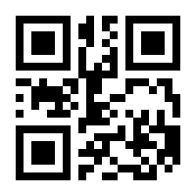
REGISTERING THE BAG:
Now take the QR code which is provided inside the box and scan it.
So, after scanning you will be registered. Make sure to connect your mobile to the bag through Bluetooth for the extensive experience.
RECHARGING:
Superior Quality and Texture,
Retract USB charging/discharging cable accessory, a single cable solution
Manually charge through low powered sources too
Plug your charging cables in the USB port
Charge any 5V USB (Mobile, tablet and type C laptops) device on the go.
Press and hold the 3rd strap button (LED illumination one) for 1.5 seconds so, the power bank will turn to charge mode.
www.Tracuz.com

Slide 5
FEATURES
Inner Illumination: There are LEDs placed inside the bag which illuminates in the dark when the zip is opened. It lights up for 15 seconds after which it shuts down. It can be manually turned ON or OFF anytime using the button on the handle or the mobile application Deep Sleep: It will help to save power by turning off all the other functionalities like sensors, front matrix LEDs and other LEDs. It can be triggered using both button on the handle or mobile application Predefined Animation: There are set of 25 predefined animations which can be displayed on the 8*8 LED Matrix display. Changing the Predefined animation can be done through the button on the handle or mobile app Custom Text Display: The rolling text can be sent through the mobile app which will get displayed on the 8*8 LED Matrix on the front of the bag Secure Mode: It is a virtual lock for the bag. In secure mode, the zipper state is checked continuously to detect any disruption in the previous state. Bag can alert its owner if someone tries to take the bag which is kept unattended.
Silent Mode: It turns off all the audio notifications by keeping haptic notifications on
Ride Mode: It enables to start navigation by visual as well as haptic notification. It can be manually controlled using the buttons on the strap
Beacon Tracking: It can be added to valuable items like wallet, house keys, laptop, etc. to enable their tracking. The bag will notify the user if there is any missing item
www.Tracuz.com

Slide 6
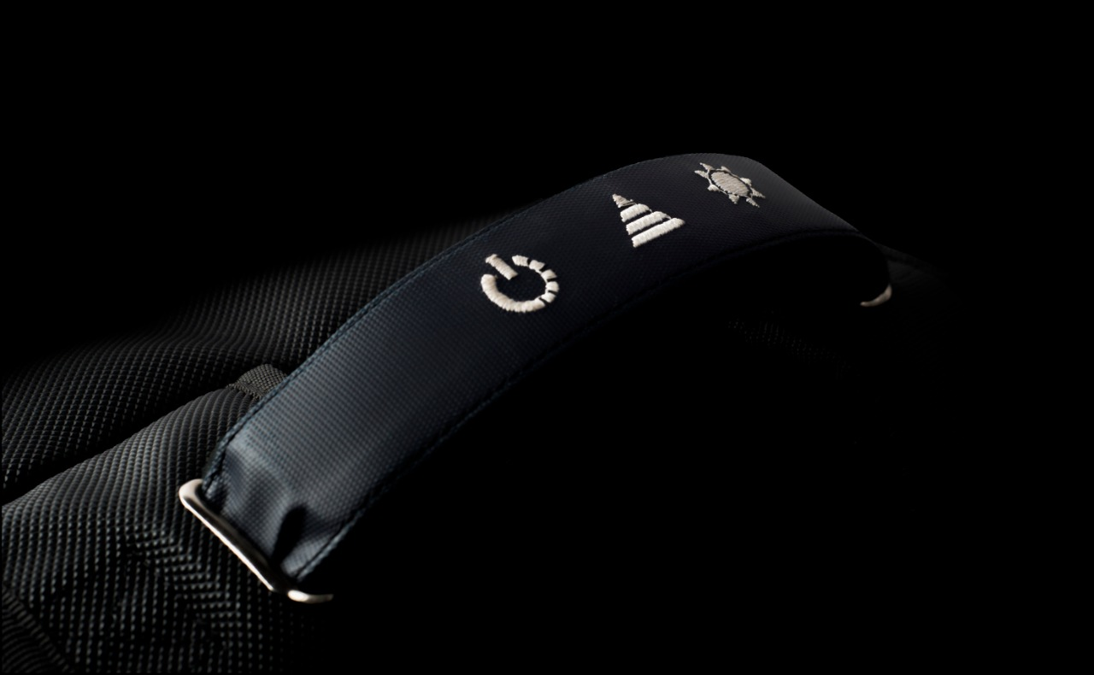
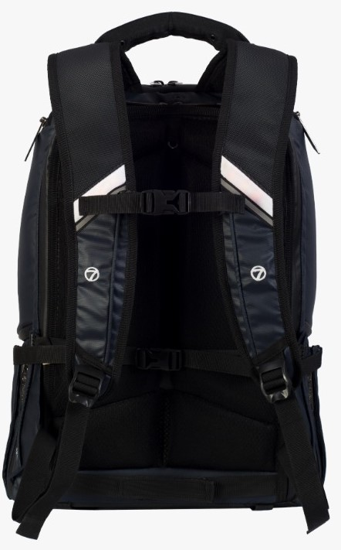
Press Me Once to turn the Secure mode ON
Press Me once to illuminate the Inner LED.
Press me again to switch OFF the LED
Press Me for 1.5 seconds to Disable Secure mode
Press Me for 1.5 seconds and I will allow You to charge Your Power Bank without getting it Out of Me with Our Special Converter
Press Here for 3 Seconds to Let Me Sleep.
Press Me for 1.5 seconds enable Silent Mode
Press Me Once to Toggle Between Pre-defined Animations
RIGHT STRAP BUTTON
LEFT STRAP BUTTON
Press once to ON/ OFF the Inner LED
Press Me Once to turn the Secure mode ON
Press Me for 3 Seconds to turn On/OFF the Ride Mode
Press Me for 1.5 seconds to turn On/OFF the Silent Mode
If you are in the Ride Mode Press Me Once to turn On/OFF the Right Indicator
If you are in the Ride Mode Press Me Once to turn ON/OFF the Left Indicator

Slide 7
Buttons | Timing state | Functionality
Power button(strap button, left most first one) | Press once | Press once to enable secure mode
 | Press & hold for 1.5 seconds | Disable secure mode
 | Press & hold for 3 seconds | Enter deep sleep mode
Triangle button(Strap button, Middle one) | Press once | Press once every time to toggle between animations
 | Press & hold for 1.5 seconds | To enter into silent mode
Light button(Strap button, Right most third one) | Press once | ON/ OFF the LED inside bag
 | Press and hold for 1.5 seconds | Trigger the power bank to charging mode
Left strap button | Press once | Enable secure mode
 | Press and hold for 1.5 seconds | Enter into the silent mode
Right strap button | Press once | To switch OFF/ ON the inner LED
 | Press and hold for 3 seconds | To switch OFF/ ON ride mode
 | Press once when ride mode ON | Left strap one press indicator ON/OFF
 | Press once when ride mode ON | Right strap one press indicator ON/OFF

Slide 8
WARRANTY DURATION:
Thank you for your interest in getting Tracuz bag. The TRACUZ bag has limited warranty, 2 years for the fabric and stitching and 3 months for the electronics.
WHAT DOES THE LIMITED WARRANTY COVER?
The Limited warranty covers any defects in material or workmanship under normal use during the warranty period. During the Warranty period, Tracuz will repair or replace, at no charge, products or parts of a product that proves defective because of improper material or workmanship, under normal use and maintenance. Damage caused due to water is not covered under warranty.
WHAT WILL WE DO TO CORRECT THE PROBLEM?
Tracuz will either repair the product at no charge, using new or revamped replacement parts.
WHAT DOES THIS LIMITED WARRANTY NOT COVER?
The limited warranty does not cover any problems that are caused by, damage not resulting from defects in material or workmanship
HOW TO OBTAIN WARRANTY SERVICE?
To obtain warranty service, you must first contact us to determine the problem and the most appropriate solution for you.

Slide 9
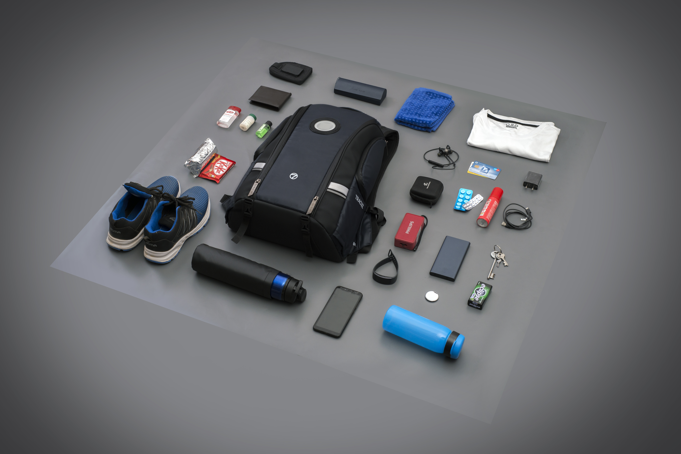
CONTACT DETAILS:
Address: 410, Vijetha Apartments, 4th Floor, Brookefield, Bangalore- 560037
Phone number: +91- 7406511990
Email ID: go@tracuz.com
www.Tracuz.com

Slide 10
